Slide 1



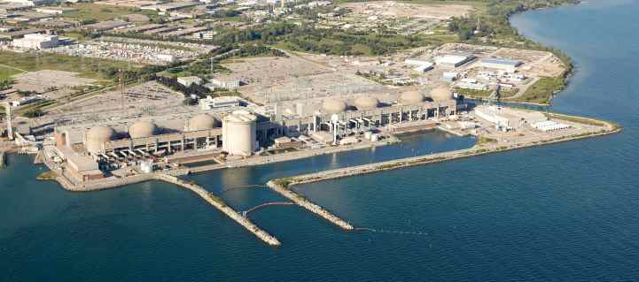

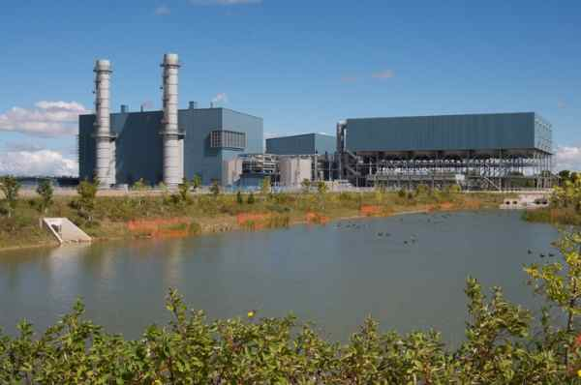
Ontario’s Energy Dilemma
Reducing Emissions at an Affordable Cost
Paul Acchione, M. Eng., P. Eng., FCAE
Management Consultant,
Market Intelligence & Data Analysis Corp. (MIDAC)
and
Member – OSPE Energy Task Force

Slide 2
Ontario’s Energy Dilemma
Reducing Emissions at an Affordable Cost
Presentation Outline
Power System Carbon Dioxide Emissions
Power System Supply and Demand
Marginal Cost of Zero Emission Electricity
Availability of Surplus Zero Emission Electricity
Case Studies
Policy Barriers to Productive Use of Surplus Zero Emission Electricity

Slide 3
Ontario’s Energy Dilemma
Power System Supply and Demand - 2016
Ontario has ample generation capacity.
Night time low load is about 70% of same day peak load.
Annual minimum low load is about 50% of annual peak load.
Spring and fall are low load periods.

Slide 4
Ontario’s Energy Dilemma
Power System Night-time Demand - 2016
At night Ontario has more zero emission electricity than demand.
The excess is currently exported at low prices or curtailed (wasted).
What if we could use that surplus to displace fossil fuels in other sectors ?
The night-time zero emission supply minus night-time demand represents the surplus zero-emission electricity during the night-time.

Slide 5
Ontario’s Energy Dilemma
Power System Day-time Demand - 2016
During the day Ontario periodically has more zero emission electricity than demand.
The excess is currently exported at low prices or curtailed (wasted).
The daytime zero emission supply minus daytime demand represents the surplus zero-emission electricity during the daytime.

Slide 6
Ontario’s Energy Dilemma
Marginal Cost of Zero-Emission Electricity
Zero emission electricity has a low marginal cost of production of
< $15/MWh or
< 1.5 cents/kWh.
An HOEP price below $15/MWh or 1.5 cents/kWh is a good indicator of when zero emission electricity is surplus and can be used to enable fuel switching to displace fossil fuels.
Above $15/MWh or
1.5 cents/kWh, gas fired generation runs at the margin and sets the price.
Below $15/MWh or 1.5 cents/kWh zero emission generation sets the price.

Slide 7
Ontario’s Energy Dilemma
Availability of Surplus Zero-Emission Electricity
Each 1 TWh is enough power for 100,000 homes for 1 year.
Surplus electricity quantities will drop when nuclear capacity is phased out or refurbished.
Surplus electricity quantities will rise again when nuclear refurbishment program ends.
Emissions will rise when nuclear capacity is reduced because gas fired generation will back up wind and solar. Storage is still too expensive to provide zero emission backup.

Slide 8
Ontario’s Energy Dilemma
Case Study – Electric Vehicles at Full Retail Electricity Cost
 | Ontario Electricity | Ontario Gasoline | G → E Change
GHG Emissions (grams CO₂/km) | 8.8 | 243.3 | - 96%
Fuel Cost (cents/km) | 3.7 | 9.7 | - 62%
NRCan reports the average light vehicle is driven 16,000 km/yr in Ontario
Annual emission reduction per electrical vehicle is 3.8 Tonnes CO₂
There are over 7,700,000 cars registered in Ontario (2014 Stats Canada).
Potential (max.) annual emission reduction is 28.9 Mega Tonnes
Notes: Gasoline at 90.9 cents/litre, electricity at average retail cost of 17.1 cents/kWh before taxes.
Consumption data from a Tesla Model X and Honda CR-V were used for the comparison.

Slide 9
Ontario’s Energy Dilemma
Case Study – Home Heating at Full Retail Electricity Cost
 | Ontario Electricity | Ontario Nat. Gas | NG → E Change
Electric
Heater
GHG Emissions (grams CO₂/kWh_{th}) | 40 | 180 | - 78%
Delivered Cost (cents/kWh_{th}) | 17.1 | 2.4 | + 613%
GHG Emissions (grams CO₂/kWh_{th}) | 20 | 180 | - 89%
Delivered Cost (cents/kWh_{th}) | 8.5 | 2.4 | + 254%
ASHP
GHG Emissions (grams CO₂/kWh_{th}) | 10 | 180 | - 94%
Delivered Cost (cents/kWh_{th}) | 4.3 | 2.4 | + 79%
GSHP
Notes: Vaughan, Ontario, sample residence. Fixed charges, HST and rebates not included.
ASHP – air source heat pump, GSHP - ground source heat pump.
Analysis was done for electricity at an average retail cost of 17.1 cents/kWh before taxes.

Slide 10
Ontario’s Energy Dilemma
Case Study - Home Heating at Full Retail Electricity Cost
Carbon displacement for home heating and for other thermal applications is not economic at the full retail cost of electricity.
Thermal applications can however use surplus zero emission electricity on an interruptible basis using fuel switching techniques.
The wholesale market price of interruptible zero emission electricity in 2016 was less than 1.6 cents/kWh, about 1/2 to 1/3 the price of natural gas on an energy equivalent basis.
That would make interruptible electricity cost effective on an energy cost basis for fuel switching applications.
We can get electricity at its interruptible rate provided we don’t increase the peak capacity demand of the power system.

Slide 11
Ontario’s Energy Dilemma
Policy Barriers to Productive Use of
Surplus Zero Emission Electricity
Currently there is no “retail” market for interruptible (surplus) electricity
All Ontario retail price plans are designed for uninterruptible electricity
Surplus electricity can displace fossil fuels in other sectors economically if we develop a retail market for interruptible electricity
All-in cost of delivered zero emission electricity is:
    90% fixed cost based on installed capacity
    10% variable cost based on energy production
Consumers can access low cost interruptible electricity if electricity is priced correctly at the retail level: 90% for “peak capacity” use, 10% for “energy” use.
Capacity use is measured in kW at system peak hours only.
Energy use is measured in kWh at all hours

Slide 12
Ontario’s Energy Dilemma
Questions ?
Notes:
OSPE presentations can be downloaded a https://www.ospe.on.ca/presentations
Would you like to become a member of OSPE? Visit:
http://www.ospe.on.ca/?page=JOIN
Membership in OSPE is free for engineering students !

Slide 13
Ontario’s Energy Dilemma
Supplementary Slides
for Q/A Session

Slide 14
Ontario’s Energy Dilemma
Generation Production Profiles – Lowest Demand Week
Hydroelectric and nuclear are dependable base-load sources.
Some gas must run for operating reserve. Typically 300 to 900 MW.
Approximately 6 to 8 TWh of zero emitting production was curtailed in 2016.
Production above the Ontario Demand line is exported or curtailed. Curtailed production is not shown.

Slide 15
Ontario’s Energy Dilemma
Generation Production Profiles – Highest Demand Week
Hydroelectric and nuclear are dependable base-load sources.
Some gas must run for operating reserve. Typically 300 to 900 MW.
Approximately 6 to 8 TWh of zero emitting production was curtailed in 2016.
Production above the Ontario Demand line is exported or curtailed. Curtailed production is not shown.

Slide 16
Ontario’s Energy Dilemma
  Life Cycle Emissions from Various Technologies
Primary Fuel | Lifecycle Emissions kg CO₂ per MWh (1) | Plant Operating Emissions kg CO₂ per MWh (2)
Coal | 1,001 | 973
Oil | 840 | Not available
Natural Gas | 469 | 398
Hydroelectric | 4 | 0
Nuclear | 17 | 0
Wind | 12 | 0
Solar PV | 46 | 0
Lifecycle Emission Data is from IPCC and reported on the CNA website.
Operating Emission Data is from OSPE report “Wind and the Electrical Grid”, March 14, 2012.
These values will trend lower for future plants as we use more zero emission energy for construction, mining, transportation and decommissioning.

Slide 17
Ontario’s Energy Dilemma
  Cost of Production from Various Technologies
Ontario Energy Board: 2016 commodity costs for “operating” plants
  Hydro-electric generation 5.7 cents/kWh
  Nuclear generation 6.8 cents/kWh
  Gas/Oil fired generation 14.0 cents/kWh
  Wind turbine generation 13.3 cents/kWh
  Solar generation 48.1 cents/kWh
  Bio-energy generation 13.0 cents/kWh
Costs above include costs for curtailment (waste).
Costs above do not include delivery and other regulatory charges.
Average commodity price was 11.3 cents/kWh.
Average Toronto residential total price was 17.8 cents/kWh + HST.
These 2 hold rates down.
These 4 push
rates higher.

Slide 18
Ontario’s Energy Dilemma
Electricity is Badly Mispriced by TOU Price Plans
NOTE: TOU rates above are for the commodity only for Nov 2015 – May 2016.

Slide 19
Ontario’s Energy Dilemma
Electricity is Badly Mispriced at the Residential Level

Slide 20
Ontario’s Energy Dilemma
Wind Production Relative to Demand
Gap between wind output and demand must be made up by backup generation or storage.
Excess wind output above demand must be stored, exported or curtailed (wasted).

Slide 21
Ontario’s Energy Dilemma
Solar Production Relative to Demand
Excess solar output above demand must be stored, exported or curtailed (wasted).
Gap between wind output and demand must be made up by backup generation or storage.

